Slide 1
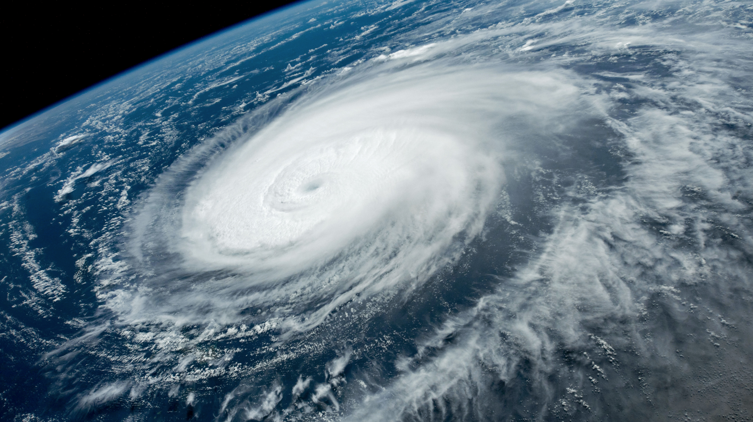
The World’s Natural Disasters
By Kristina, elee, Makram, nifa & Tran

Slide 2
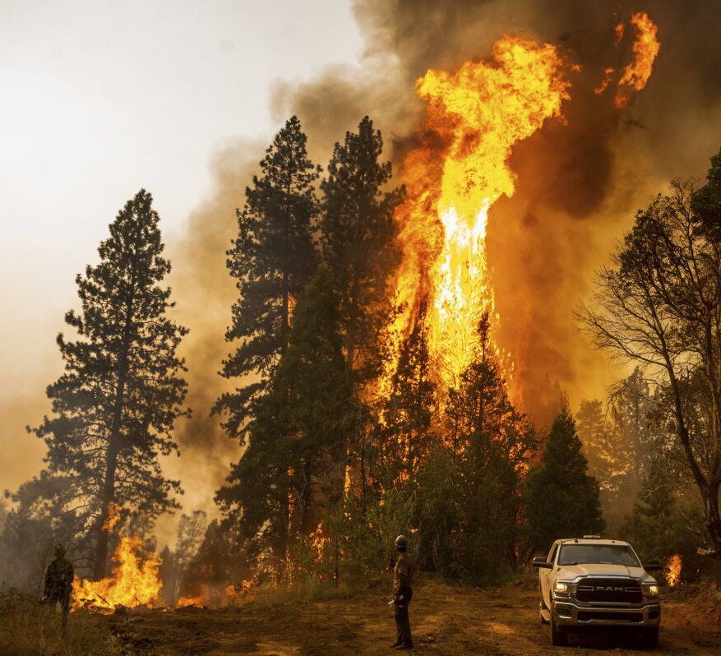
Our topic
Topic?
Natural Disasters Around The World
Why?
Understanding the parameters created by the climate crisis will be helpful in deciding the measures we will take against it.​

Slide 3
Data Source & Processing
Where? Kaggle (https://www.kaggle.com/datasets/brsdincer/all-natural-disasters-19002021-eosdis)
How many years? Data from 1900 to 2021 = 121 years of data
How many features? Over 16,000 rows, 5 columns covering key information - date, type of disaster, continent, country, no of people injured/dead/affected, costs of damages, etc..
Challenges? Not from an official source, but from public website; inconsistencies in data formatting; false values for latitude and longitude..
How?
Chose the dataset and downloaded the resources
Inspected the data
Created database via SQLite
Created the schema for future table and loaded it in DB
Loaded CSV into table
Identified and deleted unnecessary columns

Slide 4
Project Workflow
Database
Using SQLite to extract, transform (SQL schema) and load data
Backend
Building Flask and enabling routes for generating data into charts and maps
Frontend
Using JavaScript to visualize desired data, building HTML/dashboard, CSS file for styling
Finalization
Using Git Push/Pull/Commit to combine, prepare for presentation

Slide 5
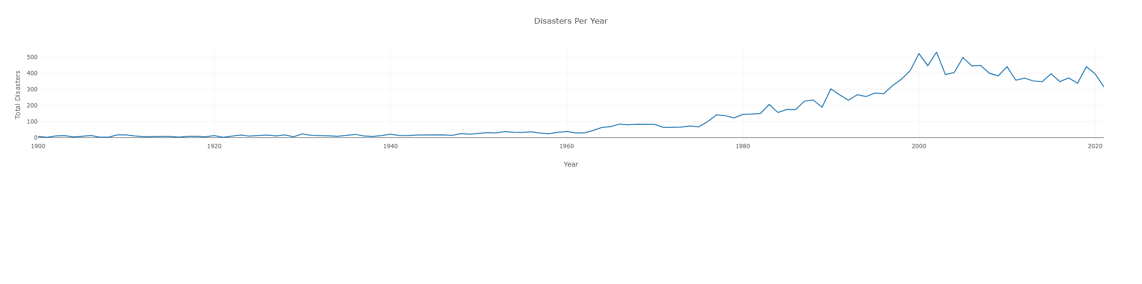
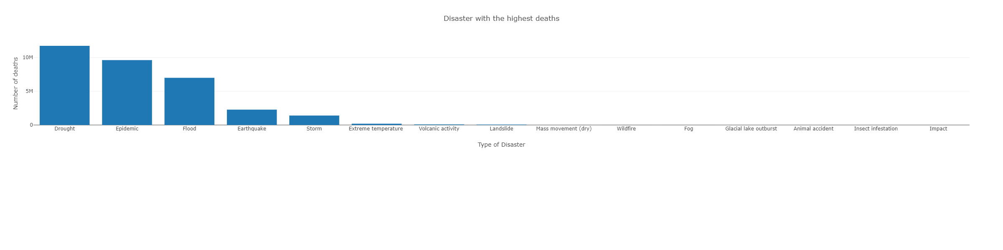
Visualization
Total of natural disasters in the world per year ranging from 1950 to 2021
Disasters with highest deaths ranging from 1950 to 2021

Slide 6
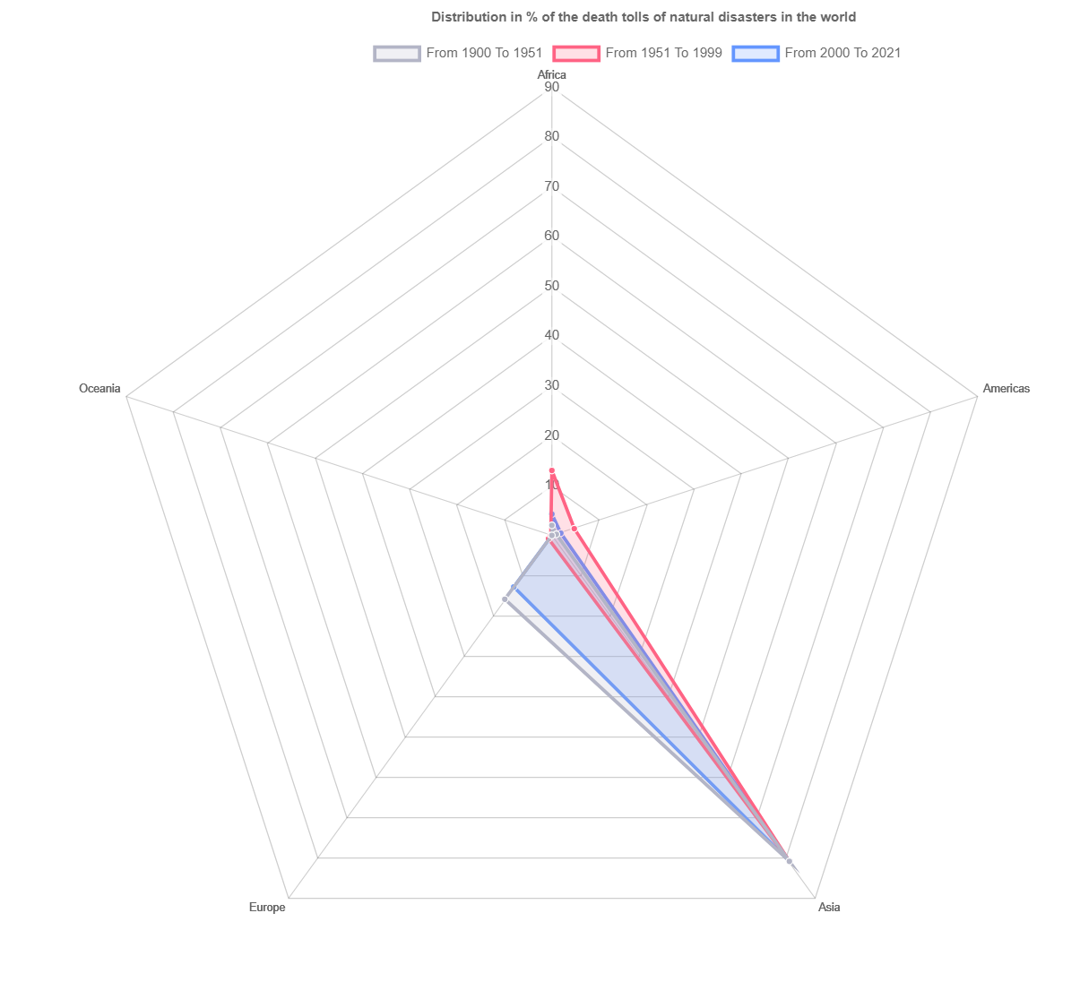
Visualization (Chart.js)
Distribution in % of the death tolls of natural disasters in the world based on continents

Slide 7
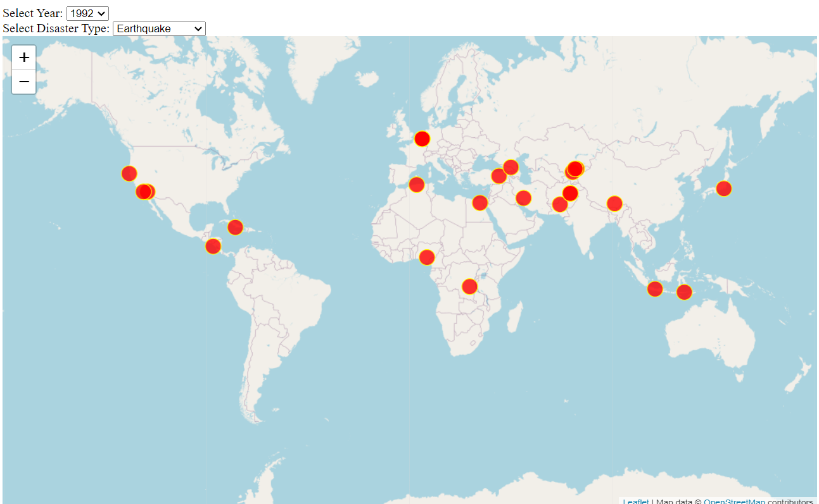
Visualization (Plotly/Leaflet)

Slide 8
Interactive Dashboard

Slide 9
Insights
In the last 20 years, disasters have not ticked up, floods and storms are the most occurring disasters in the five countries with the highest number of disasters (India, Indonesia, Bangladesh, and Iran)
Asia is leading continent where the deadliest natural disasters happened.
Geographical Vulnerability: Asia's vast size and geographical diversity contribute to its susceptibility to a wide range of natural disasters, including earthquakes, tsunamis, typhoons, floods, and volcanic eruptions.
Population Density: Asia is the most populous continent, with many densely populated urban areas. When natural disasters strike, the potential for loss of life and damage to infrastructure is higher due to the concentration of people and assets.

Slide 10
Limitations
Not from an official source; inconsistencies in data formatting; false values for latitude and longitude..
Miscommunication leading to duplicate overflows leading to wasting too much time in a certain task
Lack of Clear Roles and Responsibilities causing efficiencies and confusion

Slide 11

Thank you for listening!

